Slide 1


Technikon Full-Stack Application Project
Presentation
Armando Kostas, github.com/armandok0

Slide 2
Project Overview:
Technico is a Renovation Contractor Agency, that manages customer information, properties, and repairs.
Backend: Built with Java and Utilizes Jakarta EE to implement RESTful APIs, and deployed on WildFly, the backend handles all the data management and application logic.
Frontend: Developed using Angular, it features functionalities like user login and registration, account management, property listings, repair listings, and a user-friendly interface with a sidebar navigation.

Slide 3
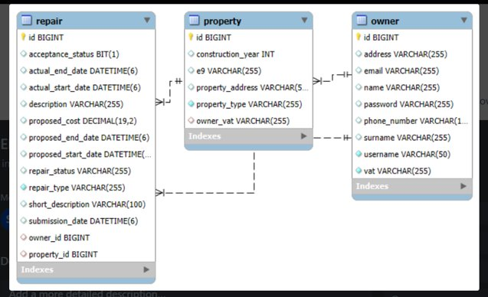
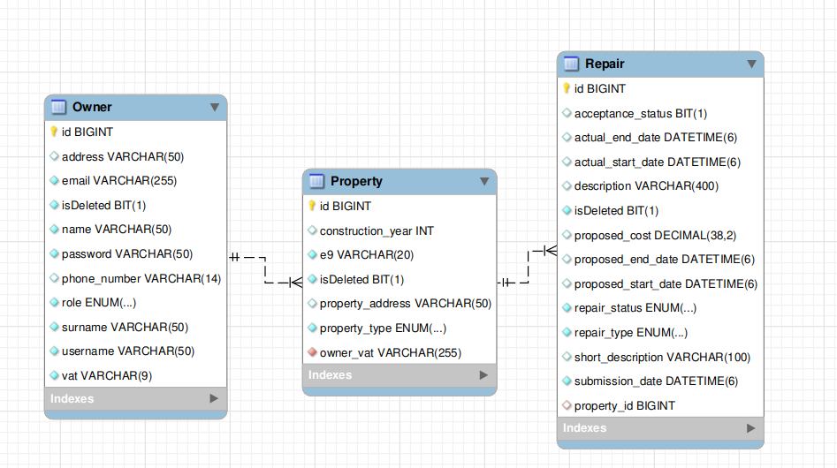
Backend:
OLD ERD:
NEW ERD:

Slide 4
Backend:
CSV files Generation
CSV files are generated for repairs, owners, and properties using the @Singleton, @Startup and @PostConstruct annotations
This ensures that these files are created automatically when the application starts, allowing for efficient data management and retrieval.

Slide 5
Backend:
Endpoints Implementation with Jakarta EE
Framework: Utilizes Jakarta EE to build a RESTful API for managing properties and owners.
Structure: Each endpoint is designed to handle specific CRUD (Create, Read, Update, Delete) operations
Utilizes @RequestScoped to ensure each request is handled independently, promoting statelessness and scalability in the application.

Slide 6
Frontend:
Architecture:
Angular Framework: Utilizes Angular for building dynamic single-page applications (SPAs).
Component-Based Structure: Each feature is encapsulated in components, promoting reusability and maintainability.
Reactive Forms: Implements Angular Reactive Forms for handling form data, validation, and user input.
Services for HTTP Communication: Angular services are used to make HTTP calls to the backend APIs.

Slide 7
Frontend:
Key Features Implemented:
Login and Register
Owner Homepage
Edit Account Page
Property Page
Repairs Page
These pages are accessible through a sidebar, offering a seamless user experience.

Slide 8
Live Demo

Slide 9
Future Enhancements:
Security Backend/Frontend:
Implement of Authentication and Authorization for Backend
More advanced encryption techniques for Data storage.
Secure URL Access and Login with stronger Authentication.
Expansions in Frontend:
Additional functionalities for Owner and Admin.

Slide 10
Thank you for your attention!
Armando Kostas, github.com/armandok0

